Slide 1


Stock Fundamental Analysis Project Presentation
Andy Chow
Keith Fu

Slide 2



Introduction & objective
Demonstrate that how can our app provide advice to our users to make better decision on the stock market
Illustrate the features of our App

Slide 3


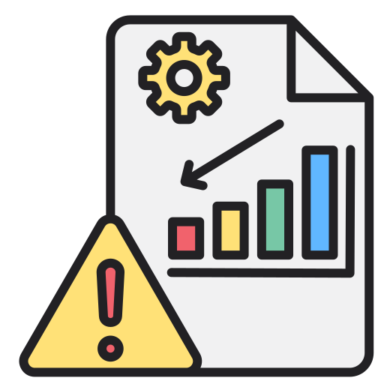

assists in risk management
The Need for Stock Fundamental Analysis
Help investors identify undervalued stocks
Assist in risk management
Develop a long-term investment strategy.

Slide 4




Pain Points in Current Stock Analysis Methods
Often time-consuming, require substantial financial knowledge
Challenging to keep up-to-date with market news and events
Subjective analysis can be prone to biases, leading to suboptimal investment decisions.

Slide 5
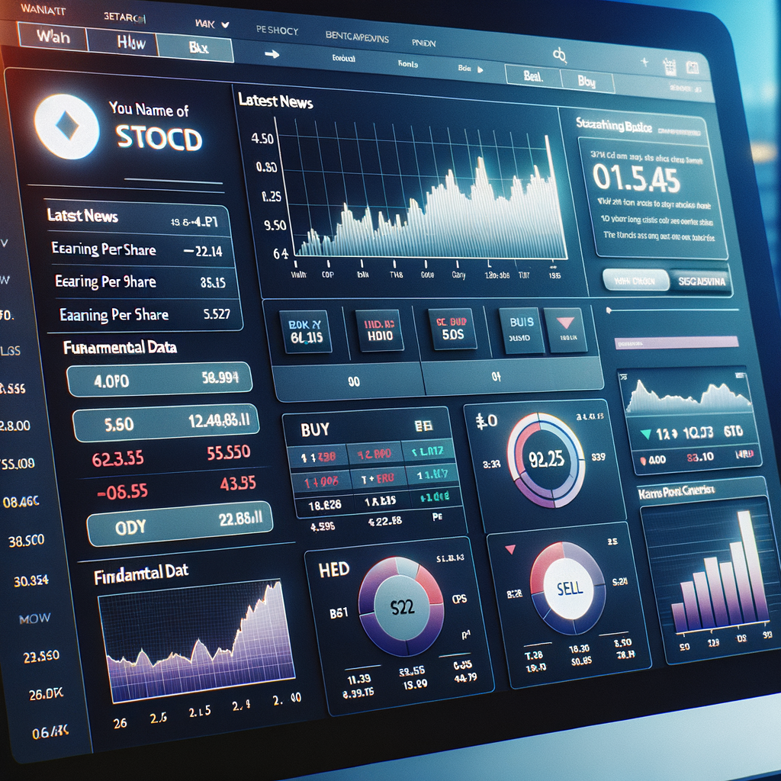

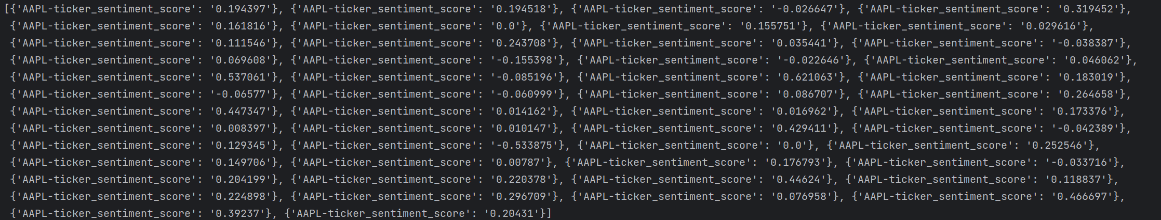
Our Solution - Automated Stock Fundamental Analysis Tool
Brief Overview
Introducing our revolutionary automated Stock Fundamental Analysis Tool. It leverages cutting-edge technology to streamline the analysis process, providing investors with real-time insights.

Slide 6

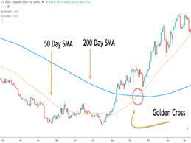

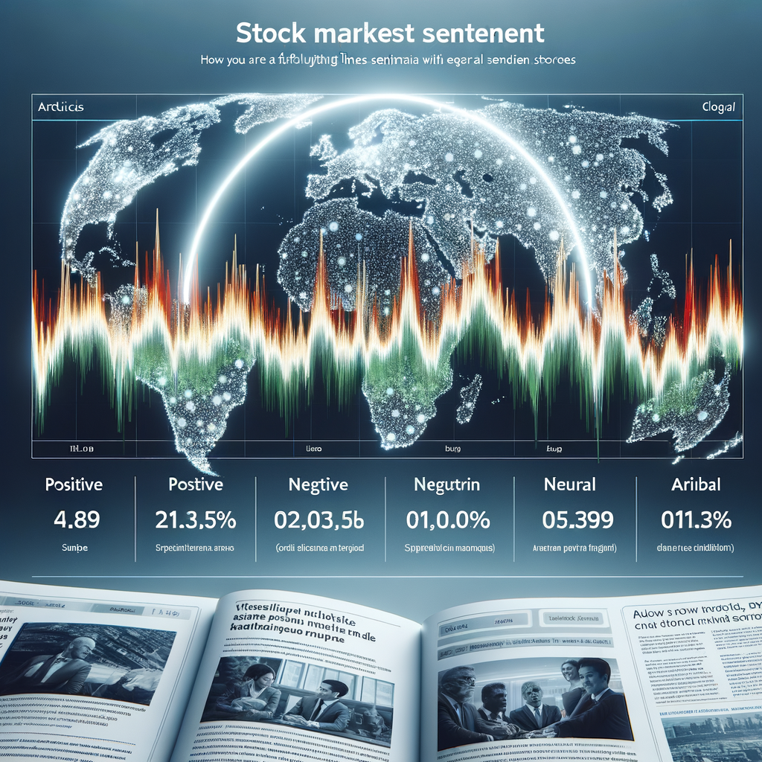
How Our Tool Works
1
Signal 1: Whether MA_50 > MA_200(BUY) / MA_50 < MA_200(SELL)
We use the data to see the MA_50 and MA_200 .
2
Signal 2: Whether Signal > 0.5(BUY) / Signal < 0.5(SELL)
We integrate the information of annual incomes, annual balances and annual cashflow to see asset &liability and P&L in order to calculate the signal .
Signal 3: whether sentiment score > 0.15 (BUY)
/ -0.15 <= overall_sentiment_score <= 0.15 (HOLD)/ sentiment
score < 0.15 (SELL)
3
The fetch news is calculated by the sentiment score to see whether we should BUY/HOLD/SELL

Slide 7



Detailed Features of the Tool
Real-time Data Collection
In-depth Financial Indicator Analysis
Our tool continuously gathers data from trusted sources, ensuring you have access to the most up-to-date information.
We provide a comprehensive analysis of various financial indicators, allowing you to gain deeper insights into the company's performance.
News Sentiment Analysis
By analyzing the sentiment score, we help you understand how market events may impact the stock's performance and your decision-making.

Slide 8
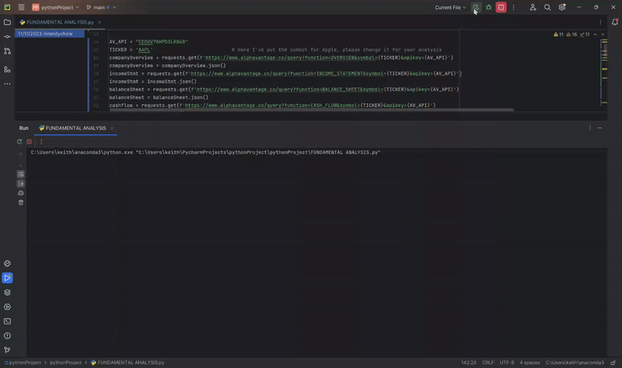
Our Tool’s Recommendation System
Automated Recommendation:
Generate a recommendation (BUY/HOLD/SELL) based on an algorithmic analysis of the stock's fundamentals and market conditions.
Guiding Investment Decisions:
Our tool empowers investors to make informed decisions based on the provided recommendation.

Slide 9
Benefits of Using Our Tool
Reduces the Need for Extensive Financial Knowledge
Saves Time
Our automated tool streamlines the analysis process, eliminating the need for manual data collection and analysis.
Even investors without extensive financial knowledge can leverage our tool to gain deep insights into stocks.
1
2
3
4
Real-time Market News and Trends
Objective Analysis
Our tool provides objective analysis, free from human biases, ensuring unbiased investment decisions.
Stay updated with real-time market news and trends, allowing you to make timely investment decisions.

Slide 10
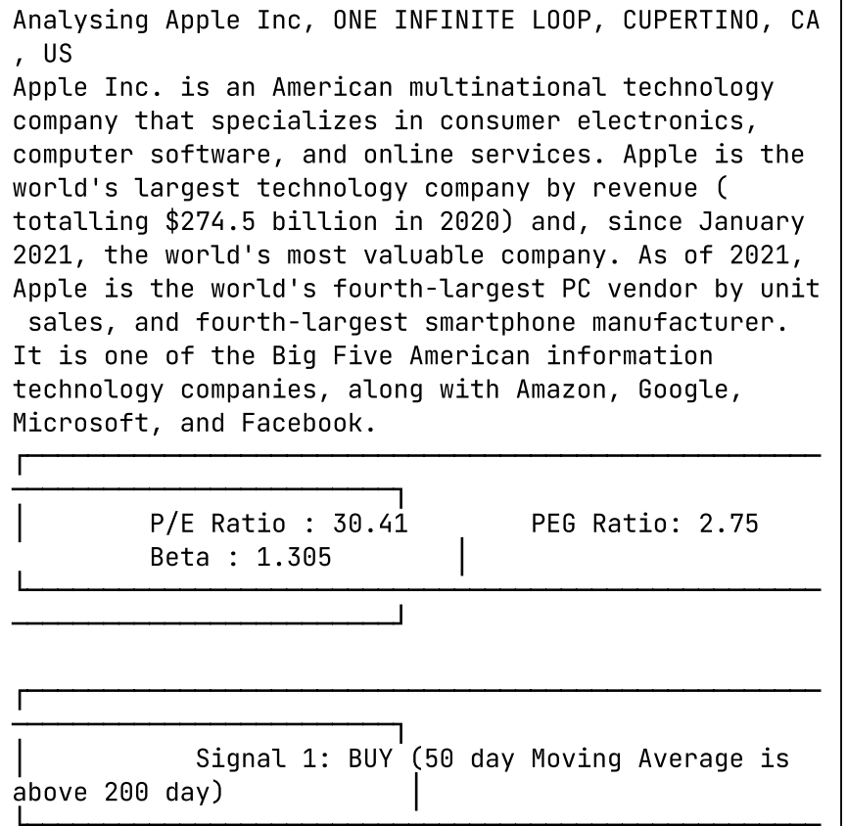
Case Study- Apple Inc,.
v
Let's explore how our tool could analyze Apple Inc,. and show the potential outcome of investing in this stock based on our analysis.
Signal 1 : MA_50 is above MA_200
> BUY

Slide 11
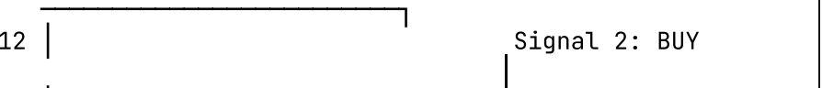
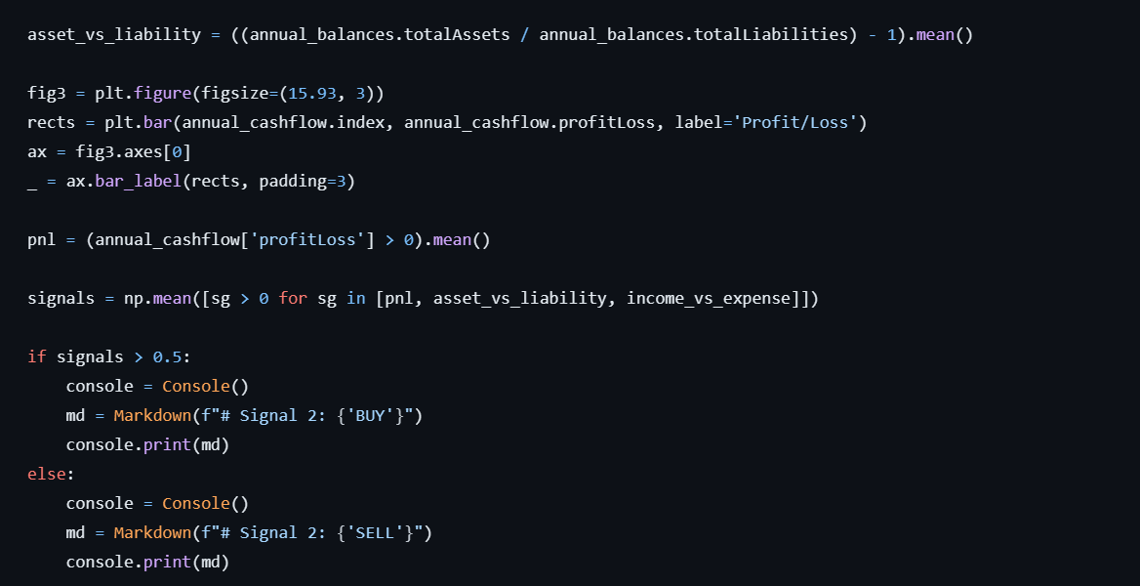
Case Study- Apple Inc,.
v
Signal 2 : Signal > 0.5 based on the PnL
> BUY

Slide 12
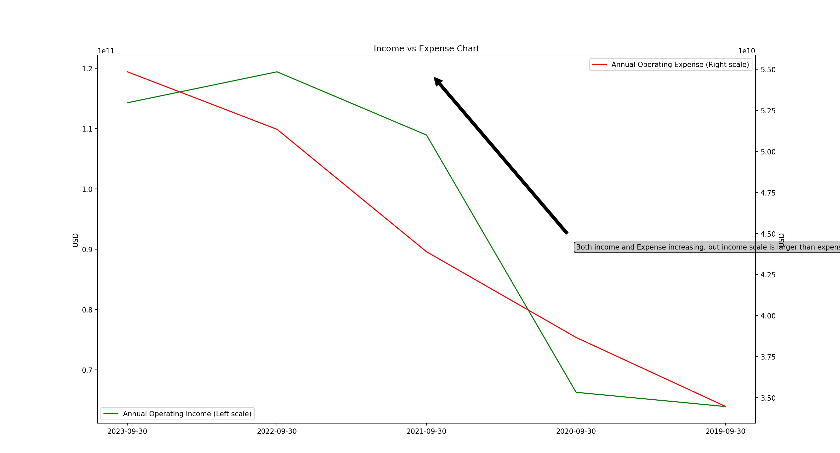
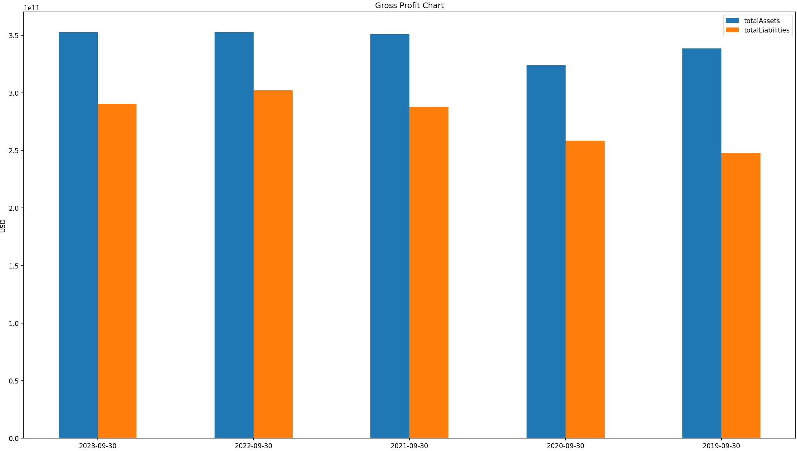
Case Study- Apple Inc,.
v

Slide 13
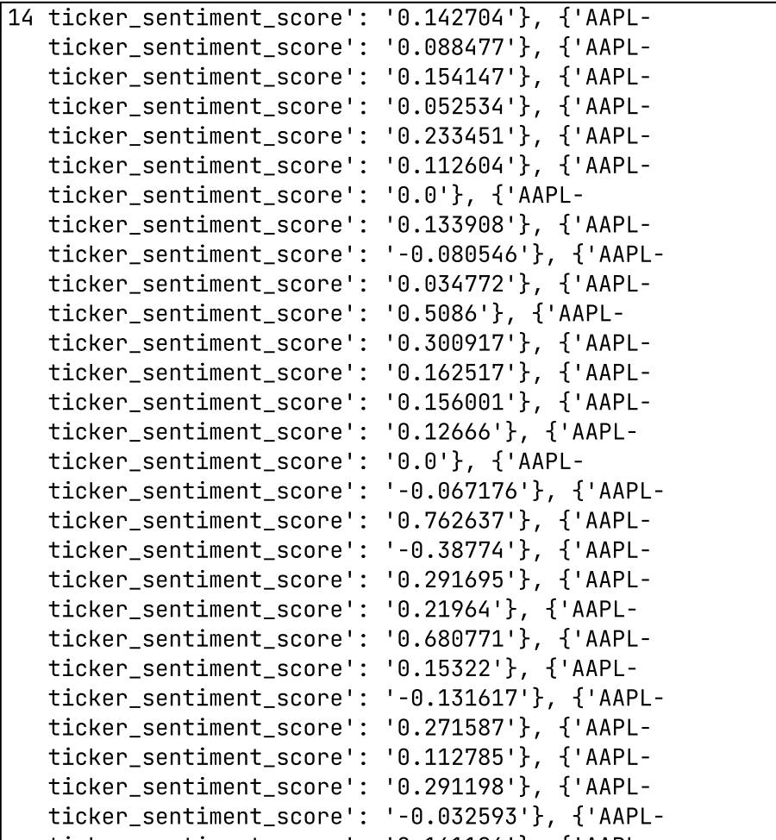
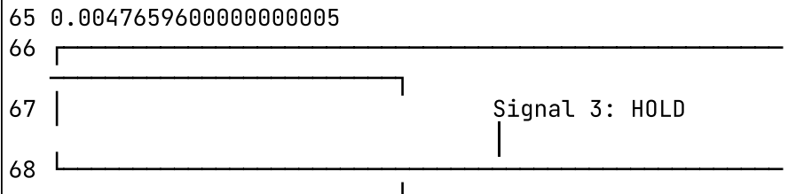
Case Study- Apple Inc,.
v
Signal 3 : -0.15 <= overall_sentiment_score <= 0.15
> HOLD

Slide 14
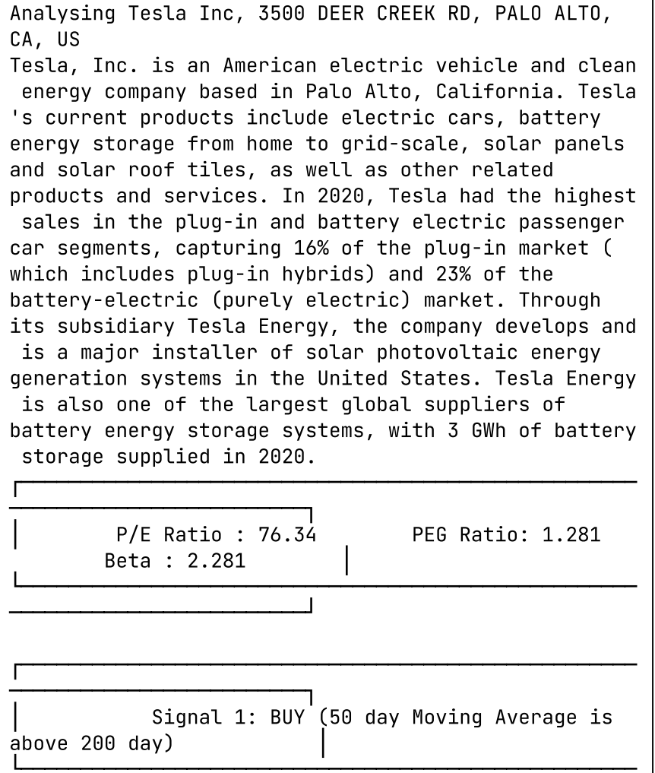
Case Study- Tesla
v
Let's explore how our tool could analyze Tesla and show the potential outcome of investing in this stock based on our analysis.
Signal 1 : MA_50 is above MA_200
> BUY

Slide 15
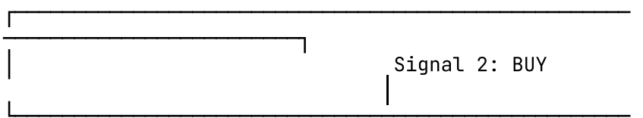
Case Study- Tesla
v
Signal 2 : Signal > 0.5 based on the PnL
> BUY

Slide 16
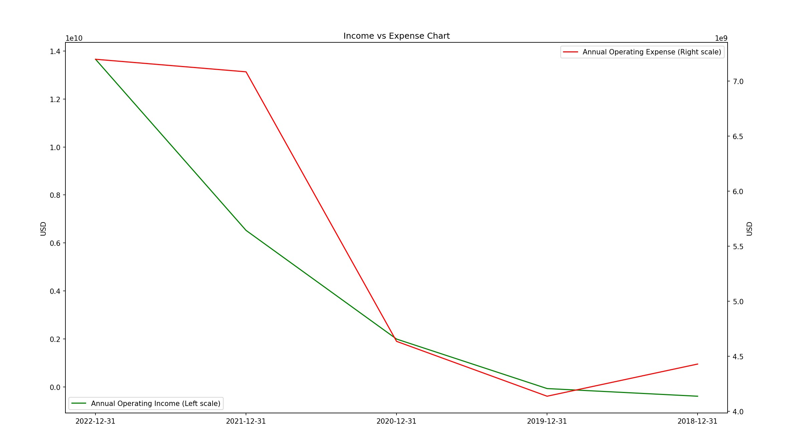
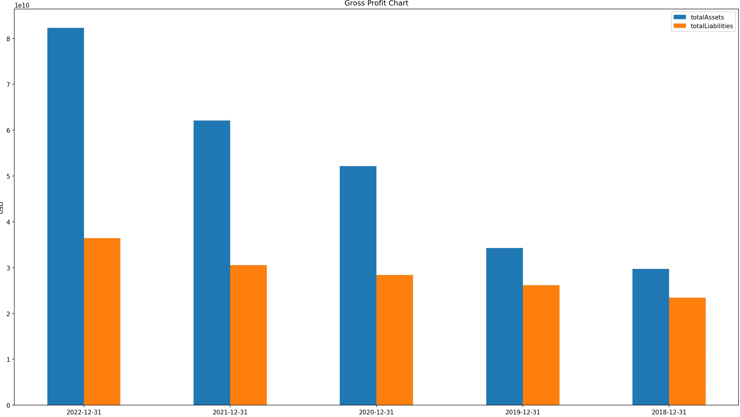
Case Study- Tesla
v

Slide 17
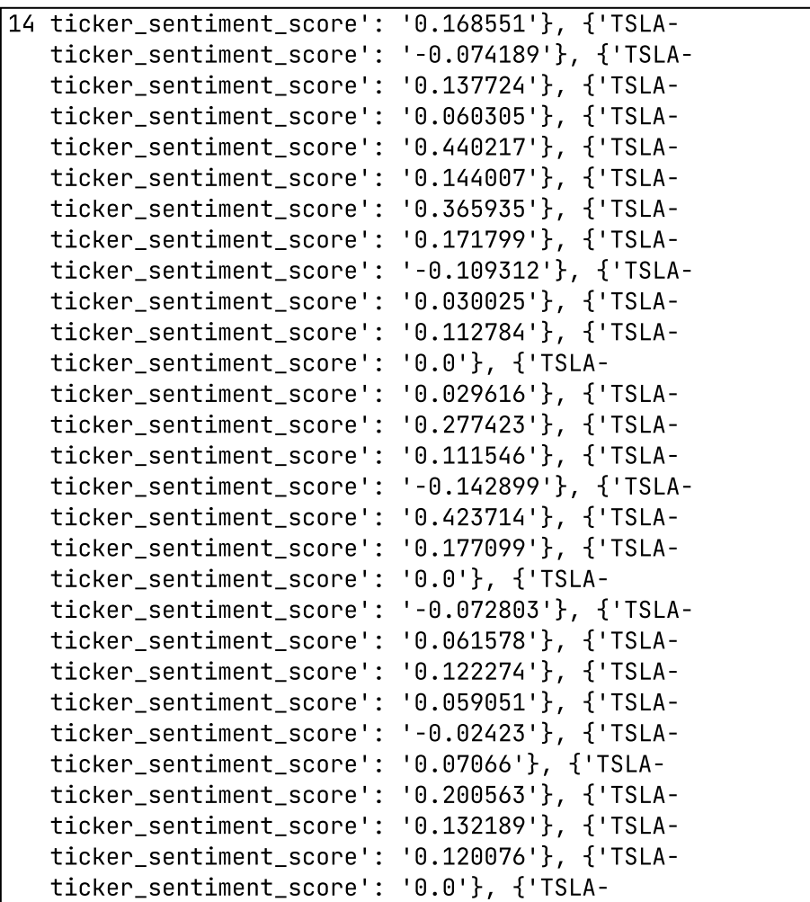

Case Study- Tesla
v
Signal 3 : -0.15 <= overall_sentiment_score <= 0.15
> HOLD

Slide 18

Future Developments
Continuous improvement and refinement of our automated analysis algorithms
Expansion of the tool's coverage to include a wider range of stocks and global markets
Incorporating user feedback to enhance the user experience and address specific investor needs

Slide 19




Conclusion
In conclusion, our automated Stock Fundamental Analysis Tool offers a game-changing approach to stock analysis. By leveraging advanced technology and real-time data:
Investors can make more informed decisions,
Save time
Achieve their investment goals.

